Slide 2
Open 06-Iteration.Rmd

Slide 3
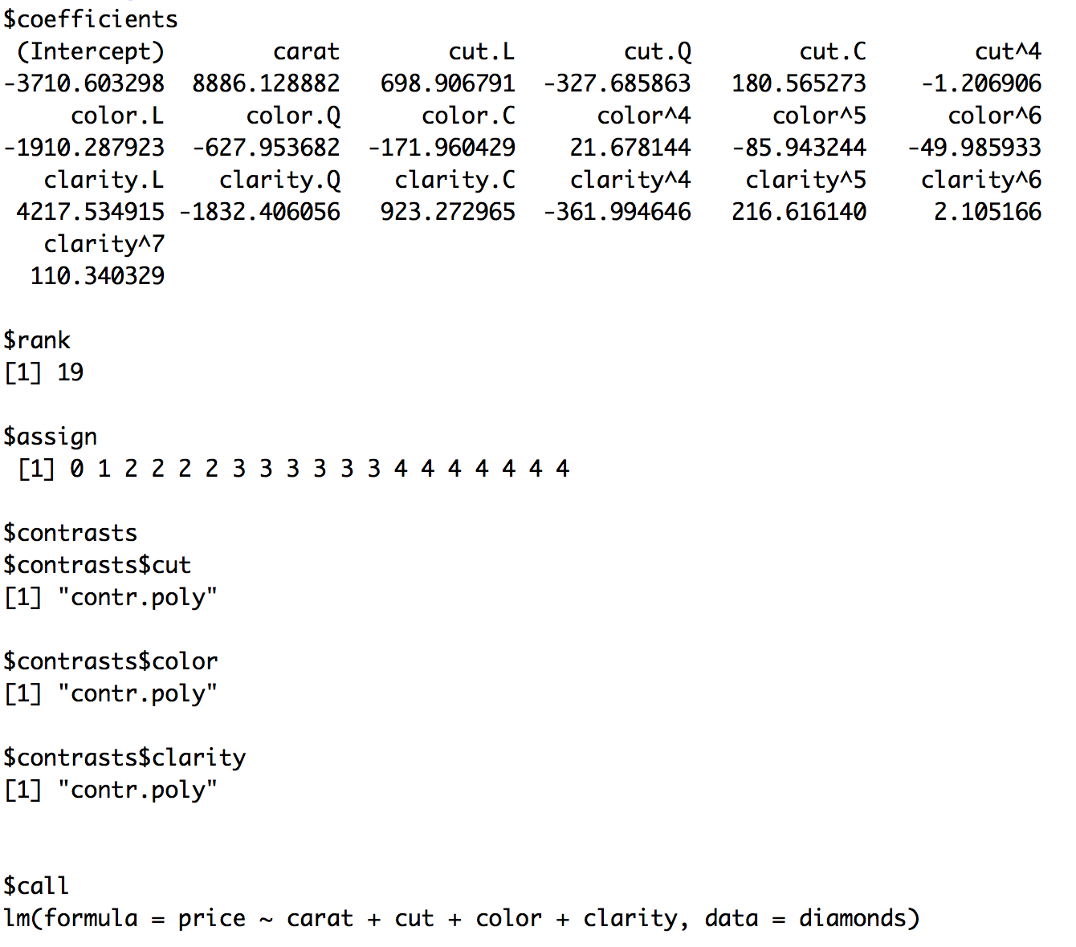
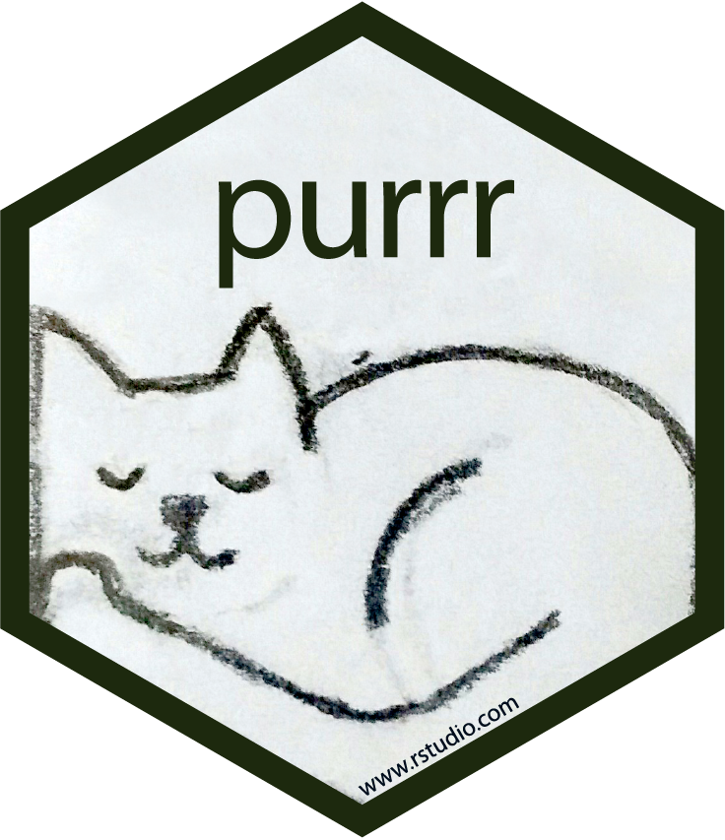
Partial output of fitting the linear model
lm(price ~ carat + cut + color + clarity, data = diamonds)
CC BY-SA RStudio

Slide 4
CC BY-SA RStudio

Slide 5

Lists

Slide 6
Quiz
What is the difference between an atomic vector and a list?

Slide 7

Atomic Vector
type
CC BY-SA RStudio

Slide 8
Atomic Vector
"one"
"two"
"three"
character
CC BY-SA RStudio

Slide 9
Atomic Vector
1
2
3
double
CC BY-SA RStudio

Slide 10
Atomic Vector
TRUE
FALSE
FALSE
logical
CC BY-SA RStudio

Slide 11
Atomic Vector
1
"two"
FALSE
?
CC BY-SA RStudio

Slide 12
Atomic Vector
"1"
"two"
"FALSE"
character
CC BY-SA RStudio

Slide 13
Atomic Vector
type
List
CC BY-SA RStudio

Slide 14
Atomic Vector
"1"
"two"
"FALSE"
character
List
CC BY-SA RStudio

Slide 15
Atomic Vector
"1"
"two"
"FALSE"
character
List
1
double
1
"two"
character
FALSE
logical
CC BY-SA RStudio

Slide 16
Atomic Vector
"1"
"two"
"FALSE"
character
List
1
double
1
"1"
"two"
"FALSE"
character
FALSE
logical
CC BY-SA RStudio

Slide 17
Atomic Vector
"1"
"two"
"FALSE"
character
List
1
double
1
"1"
"two"
"FALSE"
character
1
double
list
"1"
"two"
"FALSE"
character
FALSE
logical
CC BY-SA RStudio

Slide 18
Your Turn 1
Here is a list:
a_list <- list(num = c(8, 9),
log = TRUE,
cha = c("a", "b", "c"))
Here are two subsetting commands. Do they return the same values? Run the code chunks to confirm
a_list["num"]
a_list$num

Slide 19
a_list["num"]
$num
[1] 8 9
A list
(with one element named num that contains an atomic vector)
a_list$num
[1] 8 9
An atomic vector
CC BY-SA RStudio

Slide 20
num
log
cha
lst
c(8, 9)
TRUE
c("a", "b", "c")
lst <- list(num = c(8,9), log = TRUE, cha = c("a", "b", "c"))
CC BY-SA RStudio

Slide 21
num
log
cha
c(8, 9)
TRUE
c("a", "b", "c")
num
c(8, 9)
lst["num"]
CC BY-SA RStudio

Slide 22
num
log
cha
c(8, 9)
TRUE
c("a", "b", "c")
num
c(8, 9)
lst["num"]
lst[["num"]]
c(8, 9)
CC BY-SA RStudio

Slide 23
num
log
cha
c(8, 9)
TRUE
c("a", "b", "c")
num
c(8, 9)
lst["num"]
lst[["num"]]
c(8, 9)
lst$num
c(8, 9)
CC BY-SA RStudio

Slide 24
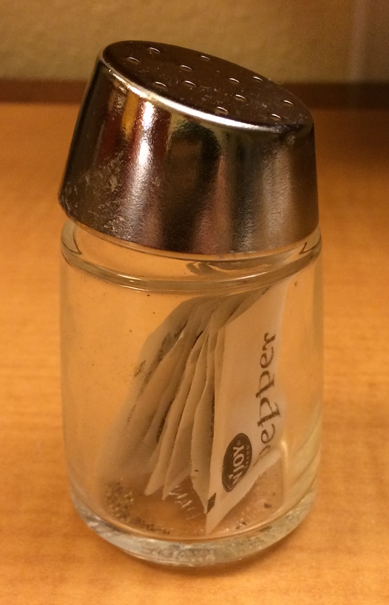
x
CC BY-SA RStudio

Slide 25
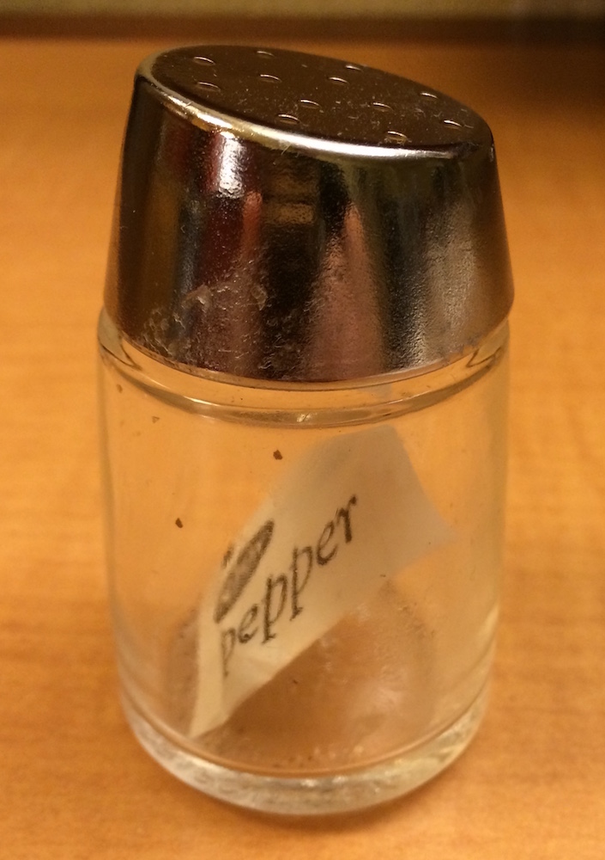
x
x[1]
CC BY-SA RStudio

Slide 26
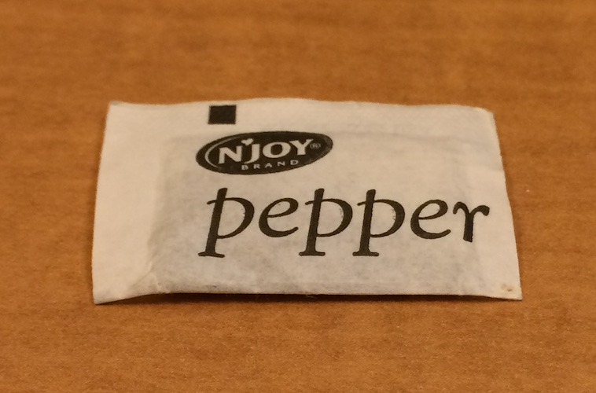
x
x[1]
x[[1]]
CC BY-SA RStudio

Slide 27
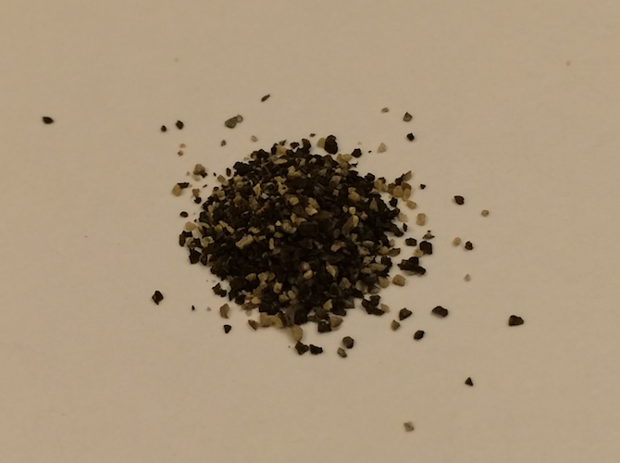
x
x[1]
x[[1]]
x[[1]][[1]]
CC BY-SA RStudio

Slide 28
Your Turn 2
What will each of these return? Run the code chunks to confirm.
vec <- c(-2, -1, 0, 1, 2)
abs(vec)
lst <- list(-2, -1, 0, 1, 2)
abs(lst)
# 2 1 0 1 2
# Error in abs(lst) :
# non-numeric argument to mathematical function

Slide 29
Take aways
Lists are a useful way to organize data.
But you need to arrange manually for functions to iterate over the elements of a list.
CC BY-SA RStudio

Slide 30
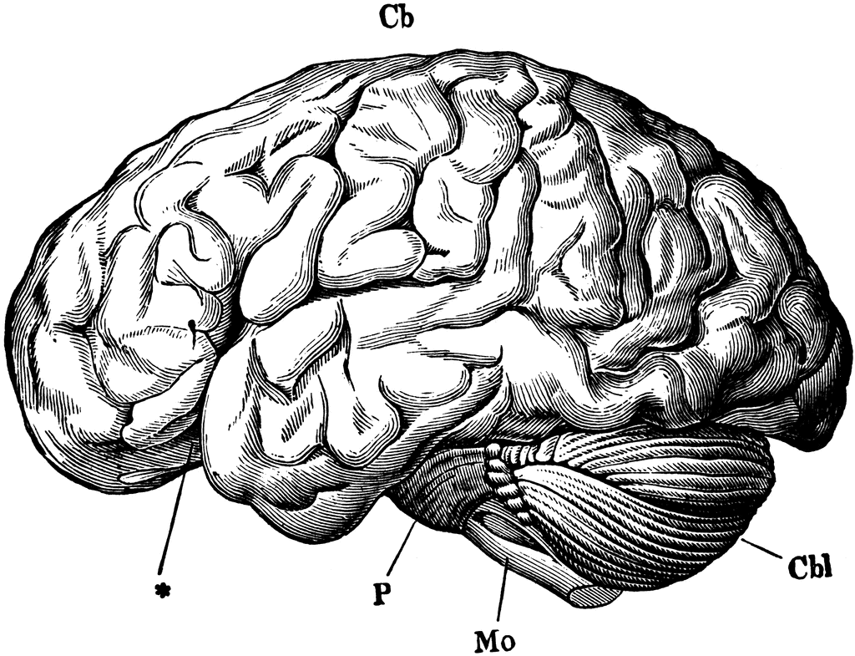
Neocortex
Limbic
System
Reptilian
Brain
CC BY-SA RStudio

Slide 31
Models
and lists
CC BY-SA RStudio

Slide 32
Lists best practices
CC BY-SA RStudio

Slide 33
Models best practices
CC BY-SA RStudio

Slide 34
Quiz
Which returns a list? Which returns a vector?
exams["student1"]
exams$student1
# list
# $student1
# [1] 66 88 56 85 76 53 87 79 61 63
# vector
# [1] 66 88 56 85 76 53 87 79 61 63

Slide 35
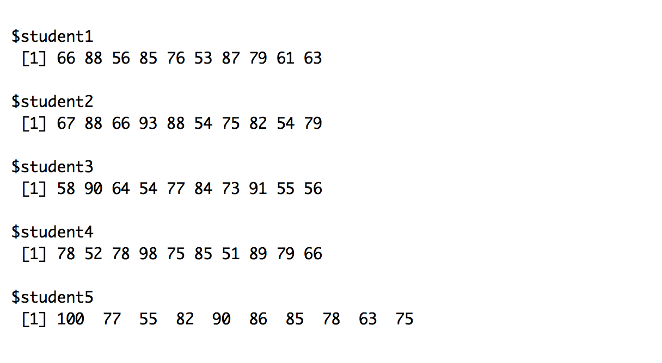
What is the average grade for each student?
exams
CC BY-SA RStudio

Slide 36
Your Turn 1
Which of these will work? Run the code chunks to confirm.
mean(exams$student1)
mean(exams)
list(student1 = mean(exams$student1),
student2 = mean(exams$student2),
student3 = mean(exams$student3),
student4 = mean(exams$student4),
student5 = mean(exams$student5))

Slide 37
Quiz
What will this return?
mean(exams$student1)
# 71.4
What will this return?
mean(exams)
# Error

Slide 38
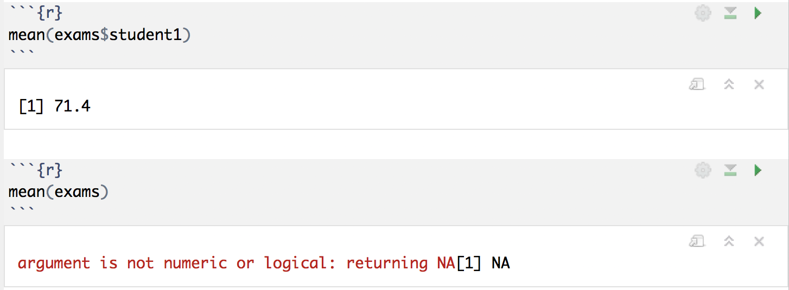
CC BY-SA RStudio

Slide 39
Iteration

Slide 40
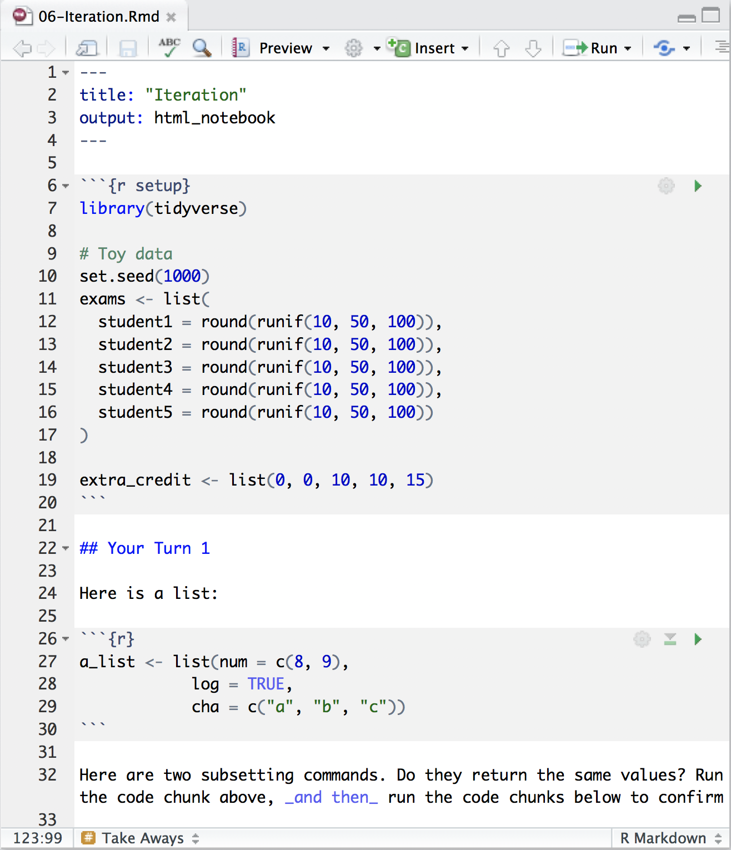
Toy data
Suppose we have the exam scores of five students…
Ensures that you
and I generate the same "random" values
CC BY-SA RStudio

Slide 41
Suppose we have the exam scores of five students…
exams
How can we compute the mean grade for each student?
CC BY-SA RStudio

Slide 42

How could we compute the average grade?
mean(exams)
CC BY-SA RStudio

Slide 43
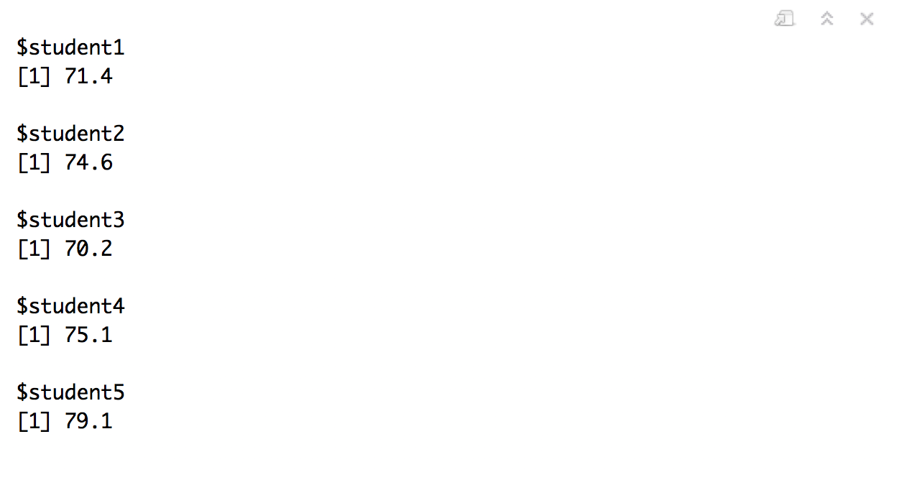
How could we compute the average grade?
list(student1 = mean(exams$student1),
student2 = mean(exams$student2),
student3 = mean(exams$student3),
student4 = mean(exams$student4),
student5 = mean(exams$student5))
Is there a better way?
CC BY-SA RStudio

Slide 44
purrr

Slide 45
purrr
Functions for working with lists.
# install.packages("tidyverse")
library(tidyverse)
CC BY-SA RStudio

Slide 46

Your Turn 3
Run the code in the chunk. What does it do?
map(exams, mean)

Slide 47
exams %>% map(mean)
CC BY-SA RStudio

Slide 48
map()
Applies a function to every element of a list.
Returns the results as a list.
map(.x, .f, …)
A list
A function to apply to each element of the list
(element become first argument)
Other arguments to pass to the function
CC BY-SA RStudio

Slide 49
map()
map(
exams
$student1
$student2
$student3
$student4
$student5
, mean, …)
exams
$student1
$student2
$student3
$student4
$student5
list
result1
result2
result3
result4
result5
mean(
, …)
mean(
, …)
mean(
, …)
mean(
, …)
mean(
, …)
CC BY-SA RStudio

Slide 50

Your Turn 4
Calculate the variance (var()) of each student’s exam grades.

Slide 51
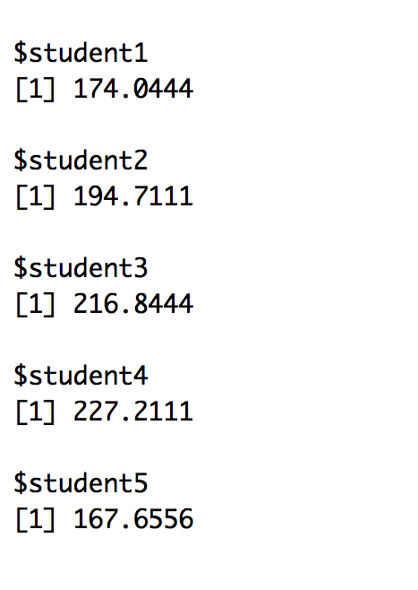
exams %>% map(var)
CC BY-SA RStudio

Slide 52
map functions
function | returns results as
map() | list
map_chr() | character vector
map_dbl() | double vector (numeric)
map_int() | integer vector
map_lgl() | logical vector
map_df() | data frame
CC BY-SA RStudio

Slide 53
map_dbl()
If we want the output as a vector:
exams %>%
map_dbl(mean)
## student1 student2 student3 student4 student5
## 71.34850 74.60950 70.21575 75.30758 79.06386
CC BY-SA RStudio

Slide 54
extra arguments
What if the grade was the 90th percentile score?
exams %>%
map_dbl(quantile, prob = 0.9)
## student1 student2 student3 student4 student5
## 87.03640 88.71630 90.34335 90.09150 90.88785
extra argument for quantile
CC BY-SA RStudio

Slide 55
map_lgl()
How about a participation grade?
exams %>%
map(length) %>%
map_lgl(all.equal, 10)
## student1 student2 student3 student4 student5
## TRUE TRUE TRUE TRUE TRUE
CC BY-SA RStudio

Slide 56
Your Turn 5
Calculate the max grade (max())for each student. Return the result as a vector.

Slide 57
exams %>%
map_dbl(max)
## student1 student2 student3 student4 student5
## 88 93 91 98 100
CC BY-SA RStudio

Slide 58
Quiz
What if what we want to do is not a function?
For example, what if the final grade is the mean exam score after we drop the lowest score?
A: Write a function.

Slide 59
Functions

Slide 60
Functions (very basics)
1. Write code that solves the problem for a real object
vec <- exams$student1
CC BY-SA RStudio

Slide 61
To write a function (very basics)
1. Write code that solves the problem for a real object
vec <- exams$student1
(sum(vec) - min(vec)) / (length(vec) - 1)
# 73.34424
CC BY-SA RStudio

Slide 62
Note: this code does the same thing no matter what vec is.
But it is a bother to redefine vec each time we use the code.
vec <- exams$student1
(sum(vec) - min(vec)) / (length(vec) - 1)
vec <- exams$student2
(sum(vec) - min(vec)) / (length(vec) - 1)
vec <- exams$student3
(sum(vec) - min(vec)) / (length(vec) - 1)
vec <- exams$student4
(sum(vec) - min(vec)) / (length(vec) - 1)
vec <- exams$student5
(sum(vec) - min(vec)) / (length(vec) - 1)
CC BY-SA RStudio

Slide 63
To write a function (very basics)
1. Write code that solves the problem for a real object
2. Wrap the code in function(){} to save it
vec <- exams[[1]]
grade <- function() {
(sum(vec) - min(vec)) / (length(vec) - 1)
}
CC BY-SA RStudio

Slide 64
To write a function (very basics)
1. Write code that solves the problem for a real object
2. Wrap the code in function(){} to save it
3. Add the name of the real object as the function argument
vec <- exams[[1]]
grade <- function(vec) {
(sum(vec) - min(vec)) / (length(vec) - 1)
}
CC BY-SA RStudio

Slide 65
To write a function (very basics)
1. Write code that solves the problem for a real object
2. Wrap the code in function(){} to save it
3. Add the name of the real object as the function argument
4. To run the function, call the object followed by parentheses.
Supply new values to use for each of the arguments.
vec <- exams[[1]]
grade <- function(vec) {
(sum(vec) - min(vec)) / (length(vec) - 1)
}
grade(exams[[2]]) # 76.93898
CC BY-SA RStudio

Slide 66
grade <- function(vec) {
(sum(vec) - min(vec)) / (length(vec) - 1)
}
exams %>%
map_dbl(grade)
## student1 student2 student3 student4 student5
## 73.34424 76.93898 72.06320 78.00649 81.68257
CC BY-SA RStudio

Slide 67
grade <- function(x) {
(sum(x) - min(x)) / (length(x) - 1)
}
exams %>%
map_dbl(grade)
## student1 student2 student3 student4 student5
## 73.34424 76.93898 72.06320 78.00649 81.68257
CC BY-SA RStudio

Slide 68
grade <- function(x) (sum(x) - min(x)) / (length(x) - 1)
exams %>%
map_dbl(grade)
## student1 student2 student3 student4 student5
## 73.34424 76.93898 72.06320 78.00649 81.68257
CC BY-SA RStudio

Slide 69
grade <- function(x) (sum(x) - min(x)) / (length(x) - 1)
exams %>%
map_dbl(function(x) (sum(x) - min(x)) / (length(x) - 1))
## student1 student2 student3 student4 student5
## 73.34424 76.93898 72.06320 78.00649 81.68257
CC BY-SA RStudio

Slide 70

Your Turn 6
Write a function that counts the best exam twice and then takes the average. Use it to grade all of the students.
1. Write code that solves the problem for a real object
2. Wrap the code in function(){} to save it
3. Add the name of the real object as the function argument

Slide 71
exams %>%
map_dbl(function(x) (sum(x) + max(x)) / (length(x) + 1))
## student1 student2 student3 student4 student5
## 72.85703 76.30779 72.12398 77.39862 80.94991
CC BY-SA RStudio

Slide 72
Quiz
What does this return?
add_1 <- function(x) x + 1
add_1(1)

Slide 73
Quiz
What does this return?
add_1 <- function(x) x + 1
add_1(1)
# 2

Slide 74
Quiz
What does this return?
add_2 <- function(x, y) x + y
add_2(2, 3)

Slide 75
Quiz
What does this return?
add_2 <- function(x, y) x + y
add_2(2, 3)
# 5
If functions can take two arguments, how can you pass two lists as the arguments?

Slide 76
map2()
Applies a function to every element of two lists.
Returns the results as a list.
map2(.x, .y, .f, …)
A list of elements to pass to the first argument of .f
A list of elements to pass to the second argument of .f
CC BY-SA RStudio

Slide 77
map2()
map2(
exams
$student1
$student2
$student3
$student4
$student5
,
extra
$extra1
$extra2
$extra3
$extra4
$extra5
, fun, …)
exams
$student1
$student2
$student3
$student4
$student5
extra
$extra1
$extra2
$extra3
$extra4
$extra5
list
result1
result2
result3
result4
result5
fun(
,
, …)
fun(
,
, …)
fun(
,
, …)
fun(
,
, …)
fun(
,
, …)
CC BY-SA RStudio

Slide 78
map functions
single list | two lists | returns results as
map() | map2() | list
map_chr() | map2_chr() | character vector
map_dbl() | map2_dbl() | double vector (numeric)
map_int() | map2_int() | integer vector
map_lgl() | map2_lgl() | logical vector
map_df() | map2_df() | data frame
CC BY-SA RStudio

Slide 79
Toy data
Suppose we have extra credit for the five students…
CC BY-SA RStudio

Slide 80
Your Turn 7
Compute a final grade for each student, where the final grade is the average test score plus any extra credit assigned to the student. Return the results as a double (i.e. numeric) vector.

Slide 81
The grades with extra credit…
exams %>%
map2_dbl(extra_credit, function(x, y) mean(x) + y)
## student1 student2 student3 student4 student5
## 71.4 74.6 80.2 85.1 94.1
CC BY-SA RStudio

Slide 82
Other mapping functions

Slide 83
pmap()
Map over three or more lists. Put the lists into a list of list whose names match argument names in the function.
pmap(list(
exams
$student1
$student2
$student3
$student4
$student5
,
extra
$extra1
$extra2
$extra3
$extra4
$extra5
,
more
$more1
$more2
$more3
$more4
$more5
), fun, …)
exams
$student1
$student2
$student3
$student4
$student5
extra
$extra1
$extra2
$extra3
$extra4
$extra5
more
$more1
$more2
$more3
$more4
$more5
fun(
,
,
, …)
fun(
,
,
, …)
fun(
,
,
, …)
fun(
,
,
, …)
fun(
,
,
, …)
CC BY-SA RStudio

Slide 84
walk(), walk_2(), and pwalk()
Versions of map(), map2(), and pmap() that do not return results. These are for triggering side effects (like writing files or saving graphs).
CC BY-SA RStudio

Slide 85
map and walk functions
single list | two lists | n lists | returns results as
map() | map2() | pmap() | list
map_chr() | map2_chr() | pmap_chr() | character vector
map_dbl() | map2_dbl() | pmap_dbl() | double vector (numeric)
map_int() | map2_int() | pmap_int() | integer vector
map_lgl() | map2_lgl() | pmap_lgl() | logical vector
map_df() | map2_df() | pmap_df() | data frame
walk() | walk2() | pwalk() | side effect
CC BY-SA RStudio

Slide 86
Practice

Slide 87

Your Turn
Use rnorm() and a map function to make test results for three students. Save the result as tests.
Student 1 has 5 tests with a mean of 70 and a sd of 20
Student 2 has 5 tests with a mean of 80 and a sd of 15
Student 3 has 5 tests with a mean of 90 and a sd of 15
Use runif() and a map to make homework results for the students. Save the result as homeworks.
Student 1 has 5 homeworks with a min of 80 and a max of 95
Student 2 has 6 homeworks with a min of 75 and a max of 90
Student 3 has 7 homeworks with a min of 70 and a max of 100
Compute the grade for each student a student's grade is 0.8 * the average test score plus 0.2 * the average homework score. Save the result as grades.
Use purrr functions and tibble() to turn each element of grades into a tibble with one row and one column. Then use a purrr function and write_csv() to save the tibbles to your working directory as "student1.csv", "student2.csv", "student3.csv".

Slide 88
tests <-
map2(list(70, 80, 90), list(20, 15, 15), rnorm, n = 5)
homeworks <-
list(n = list(5, 6, 7),
min = list(80, 75, 70),
max = list(95, 90, 100)) %>%
pmap(runif)
grades <-
map2(tests, homeworks,
function(x, y) .8 * mean(x) + .2 * mean(y))
CC BY-SA RStudio

Slide 89
filenames <-
list("student1.csv",
"student2.csv",
"student3.csv")
grades %>%
map(tibble) %>%
walk2(filenames, write_csv)
CC BY-SA RStudio

Slide 90
List columns

Slide 91
Quiz
How is a data frame/tibble similar to a list?

Slide 92
A data frame/tibble is a list!
List
data frame
num | cha | log
1 | "one" | TRUE
2 | "two" | FALSE
3 | "three" | FALSE
1
2
3
double
=
"one"
"two"
"three"
character
TRUE
FALSE
FALSE
logical
+ class = "data.frame"
CC BY-SA RStudio

Slide 93
A data frame/tibble is a list!
data frame
df["num"]
df[["num"]]
num | cha | log
1 | "one" | TRUE
2 | "two" | FALSE
3 | "three" | FALSE
num
1
2
3
df$num
c(1, 2, 3)
CC BY-SA RStudio

Slide 94
A data frame/tibble is a list!
data frame
df %>% select(num)
num | cha | log
1 | "one" | TRUE
2 | "two" | FALSE
3 | "three" | FALSE
num
1
2
3
?
CC BY-SA RStudio

Slide 95
Quiz
If you one of the elements of a list can be another list,
can one of the columns of a data frame be another list?
List
data frame
1
2
3
double
?
num | cha | listcol
1 | "one" | 1
2 | "two" | c("1", "two", "FALSE")
3 | "three" | FALSE
=
"one"
"two"
"three"
character
1
double
"1"
"two"
"FALSE"
character
list
FALSE
logical

Slide 96
Yes.
tibble(
num = c(1, 2, 3),
cha = c("one", "two", "three"),
listcol = list(1, c("1", "two", "FALSE"), FALSE)
)
# A tibble: 3 × 3
num cha listcol
<dbl> <chr> <list>
1 1 one <dbl [1]>
2 2 two <chr [3]>
3 3 three <lgl [1]>
CC BY-SA RStudio

